Slide 1
Build Your Own AI/ML Model
TEAM_CARBON
Aswin Vijayakumar

Slide 2
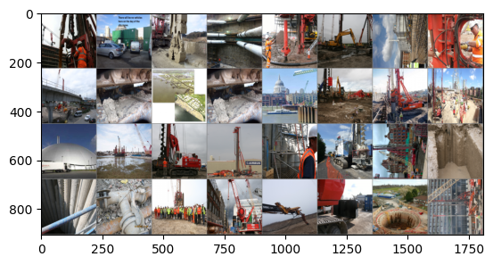
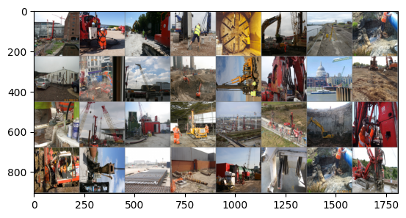
The Dataset
Construction Dataset Object Detection Dataset and Pre-Trained Model by KlinterAI (roboflow.com)
Permission Granted
1836 images
ISSUE
POTENTIAL ISSUE
RISK
POTENTIAL RISK
VISUAL SENTIMENT ANALYSIS
Notes:
I collected the Dataset from 14k+ images, I conducted Image Clustering on Few to reduce it to 1836 images.
The Dataset consists of Construction Site Images eliciting Risk content in the picture.
The Risk Content is measured using the 4 classes:
1. Risk, 2. Issue, 3. Potential Risk, and 4. Potential Issue

Slide 3
Anomaly Detection or Sentiment Analysis
Sl. No. | Image Filename | Anomaly | Anomaly | Classification of Image
1 | Cluster-Safe-\\0\\image-3.jpeg | 0 | Normal | Potential Issue
2 | Cluster-Safe-\\0\\image-9.jpeg | 0 | Normal | Potential Issue
3 | Cluster-Safe-\\0\\image-11.jpeg | 1 | Anomaly | Issue
4 | Cluster-Safe-\\0\\image-14.jpeg | 1 | Anomaly | Issue
5 | Cluster-Safe-\\0\\image-34.jpeg | 0 | Normal | Potential Issue
6 | Cluster-Safe-\\0\\image-44.jpeg | 0 | Normal | Potential Issue
7 | Cluster-Safe-\\0\\image-53.jpeg | 1 | Anomaly | Issue
8 | Cluster-Safe-\\0\\image-66.jpg | 0 | Normal | Potential Issue
9 | Cluster-Safe-\\0\\image-72.jpg | 0 | Normal | Potential Issue
10 | Cluster-Safe-\\0\\image-74.jpg | 1 | Anomaly | Issue
11 | Cluster-Safe-\\0\\image-76.jpg | 0 | Normal | Potential Issue
12 | Cluster-Safe-\\0\\image-78.jpg | 1 | Anomaly | Risk
13 | Cluster-Safe-\\0\\image-83.jpg | 1 | Anomaly | Risk
14 | Cluster-Safe-\\0\\image-87.jpg | 1 | Anomaly | Issue
Sentiment Analysis with
57.35% Accuracy
Notes:
Individually at every Image I classified the Risk Sentiment into these 4 classes.
This gave out Anomalies in the Dataset that correspond to Risk Content to those that do not have any Risk Content or Activity.
The Dataset forms Visual Sentiment Analysis and I got the Dataset trained for a 57.35% accuracy by learning features of the images.

Slide 4
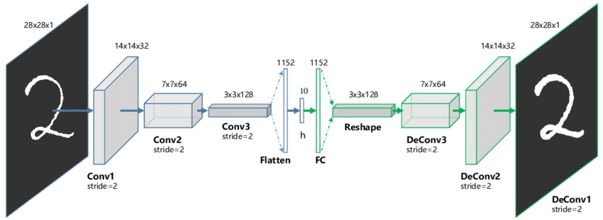
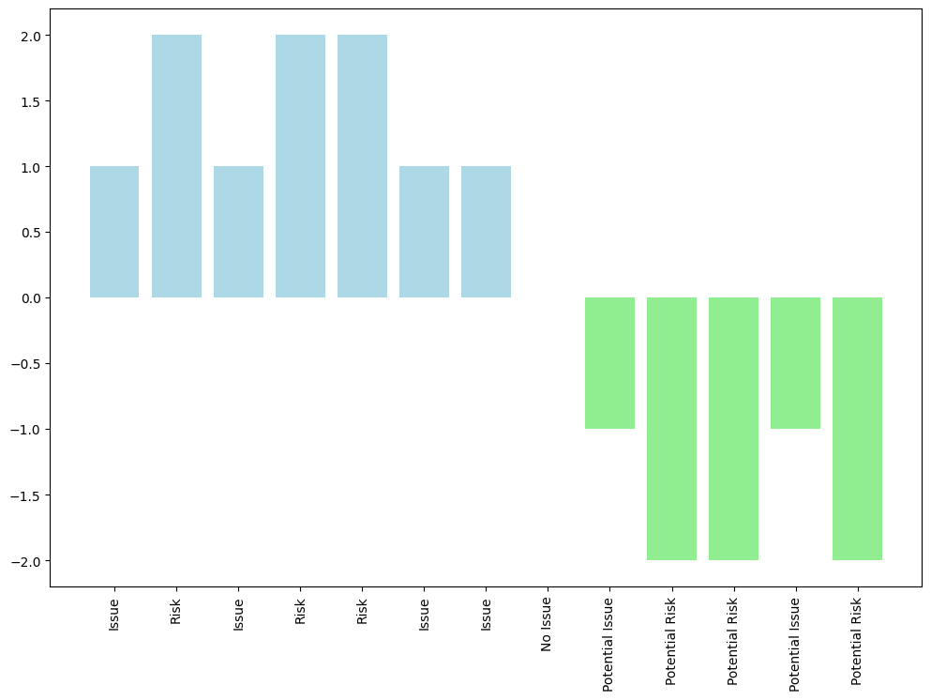
Convolutional Autoencoder Model
Notes:
This is the Convolutional Autoencoder which uses Feature Representation of the Visual Sentiment Analysis Images to Train an ML Model for Inference.
Image Inference is performed into 5 classes: Risk, Issue, Potential Risk, Potential Issue and No Issue.
PyTorch is used to Train the Convolutional Autoencoder. Feature Representation comprises of 5 classes and the Flattened Array.
In a Convolutional Autoencoder, Model, Training is conducted with Sigmoid as Activation Function at the End, taking the Loss Function as MSE (Mean Squared Error) Loss Function equating Both Input and Output forming an Image Reconstruction Senario. The Policy of the Model attached to the Node of the Model Output is The Rollover Sum of the output of the 5 classes. This Rollover Sum Metric reduces the Effective Number of Frames Per Second into the Number of Blocks Per Second. This way we can evaluate a Video into the Number of Blocks Per Second.

Slide 5
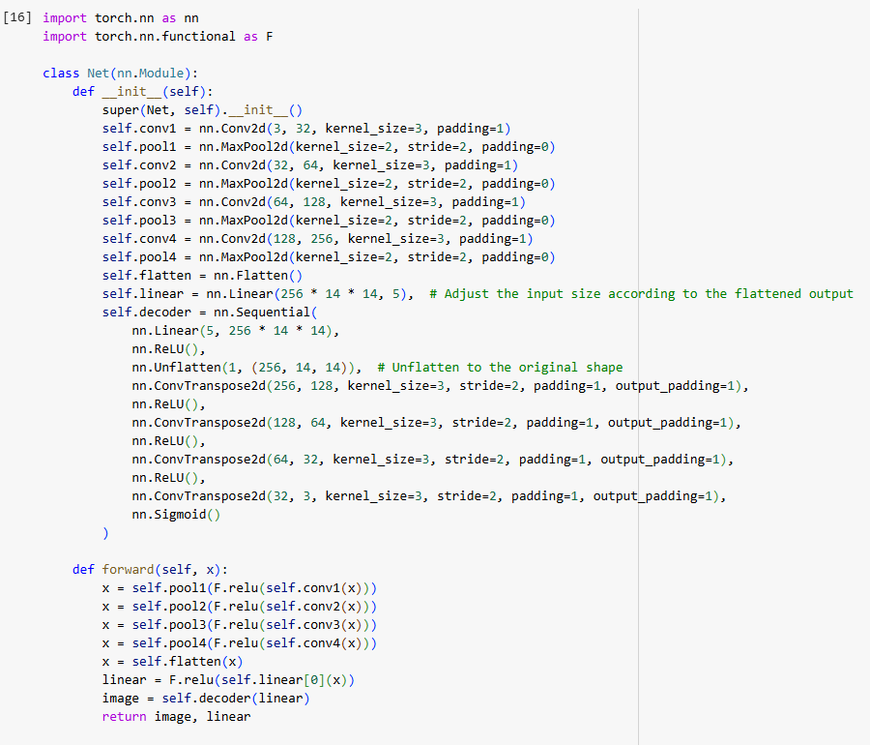
Convolutional Autoencoder Model
Notes:
This is the Coding Scheme of the Convolutional Autoencoder Model, the Visual Sentiment Analysis Model, with The Encoder, Feature Representation Layers and The Decoder. Model Layer Cutting process is performed to extract Features off the Model. The Image Sizes are taken to be 224x224 and Color Images are Passed to the Inputs and Outputs. The Layers are cut to only 5 features mapping to 5 classes of the Images in a Visual Sentiment Analysis (VSA) Scenario. There are many Autoencoders but I took Convolutional Autoencoder because of Color inside Images. The Model is trained with 5 epochs, and consisted of 41 iterations of 32 batch size images comprising 1836 images in train and test phase. Train/Test split was taken to be approximately 30%.

Slide 6
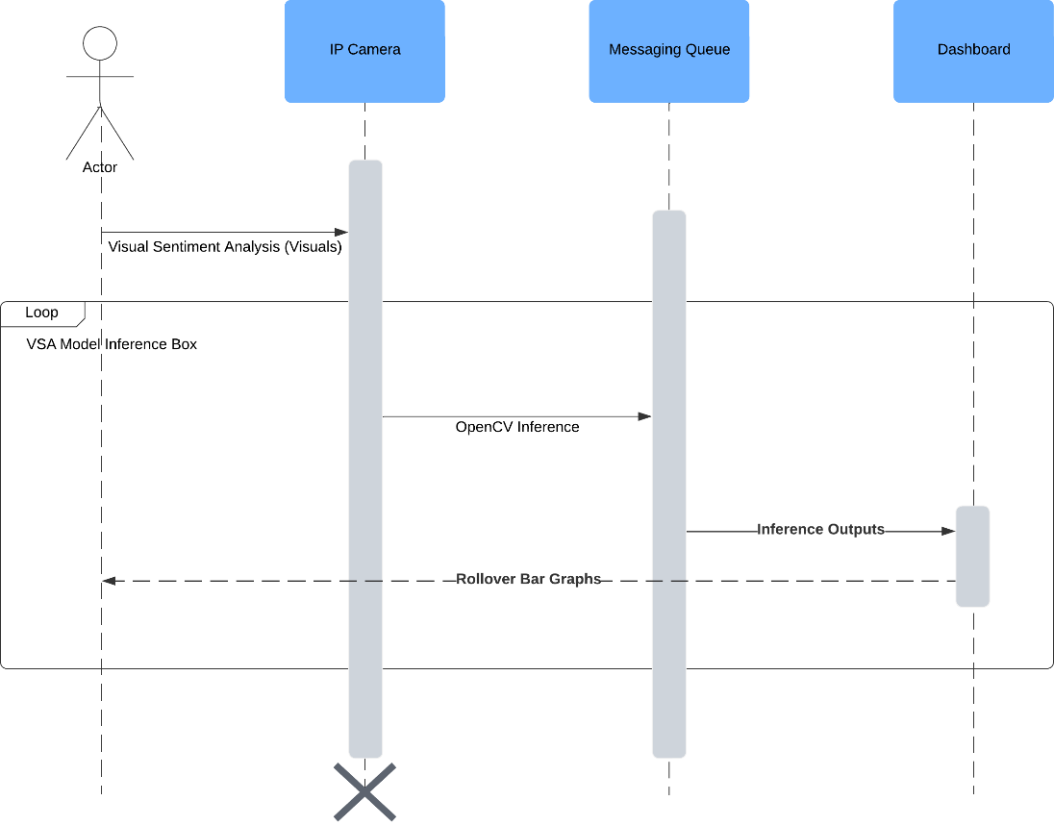
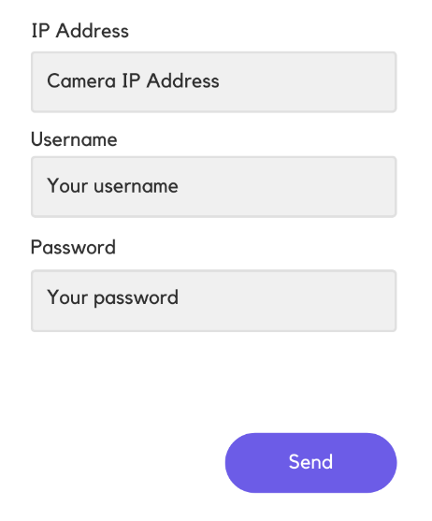
xApp – Dashboard + MQTT Broker
Notes:
This is the xApp as per the ITU.3072 and the ITU.3061 Standards. Our xApp is a Dashboard and MQTT Broker with Messaging Queue installed inside the Cabin. In the Dashboard xApp, the Visual Sentiment Analysis (Visuals) are sent to the IP Camera, which is then OpenCV Inferenced inside the MQTT Broker and Messaging Queue placed at the Cabin; and its inference outputs are sent to the Dashboard for a Visualization.
The Visualization Outputs Rollover Graphs of Risk Content Inside the Visuals as seen by the IP Camera.
Initial Configuration of the IP Camera comprises of the RTSP Ports involving The Username, The Password and Camera IP Address.

Slide 7
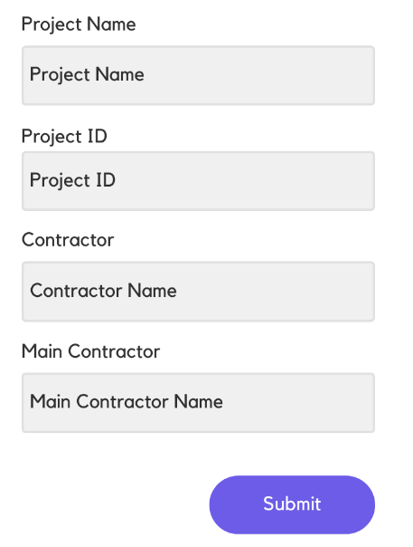
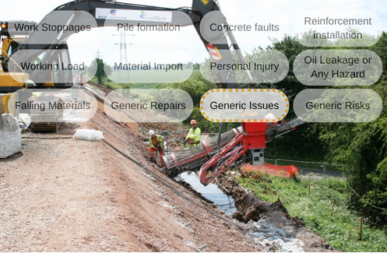
rApp - EquipAny
Notes:
This is the rApp, the Non-Real-Time App, of the KlinterAI ecosystem for a Forensic Delay Analysis. The rApp, EquipAny, helps in identification of Risks from a Photograph taken from the Mobile Device. In this slide, the Landscape Image of the Mobile Device or a Tablet device with Hover Over Types of Issues are shown. This Photograph is a Typical Example of Generic Issues occurring at a Construction Site. Apart from Generic Issues, there are Work Stoppages, Pile Formation, Concrete Faults, Working Load, material Import and Falling Materials to be recorded as case reports. The Initial Configuration of this rApp, EquipAny, comprises of the Project Name, Project ID, Contractor and Main Contractor Names too.

Slide 8
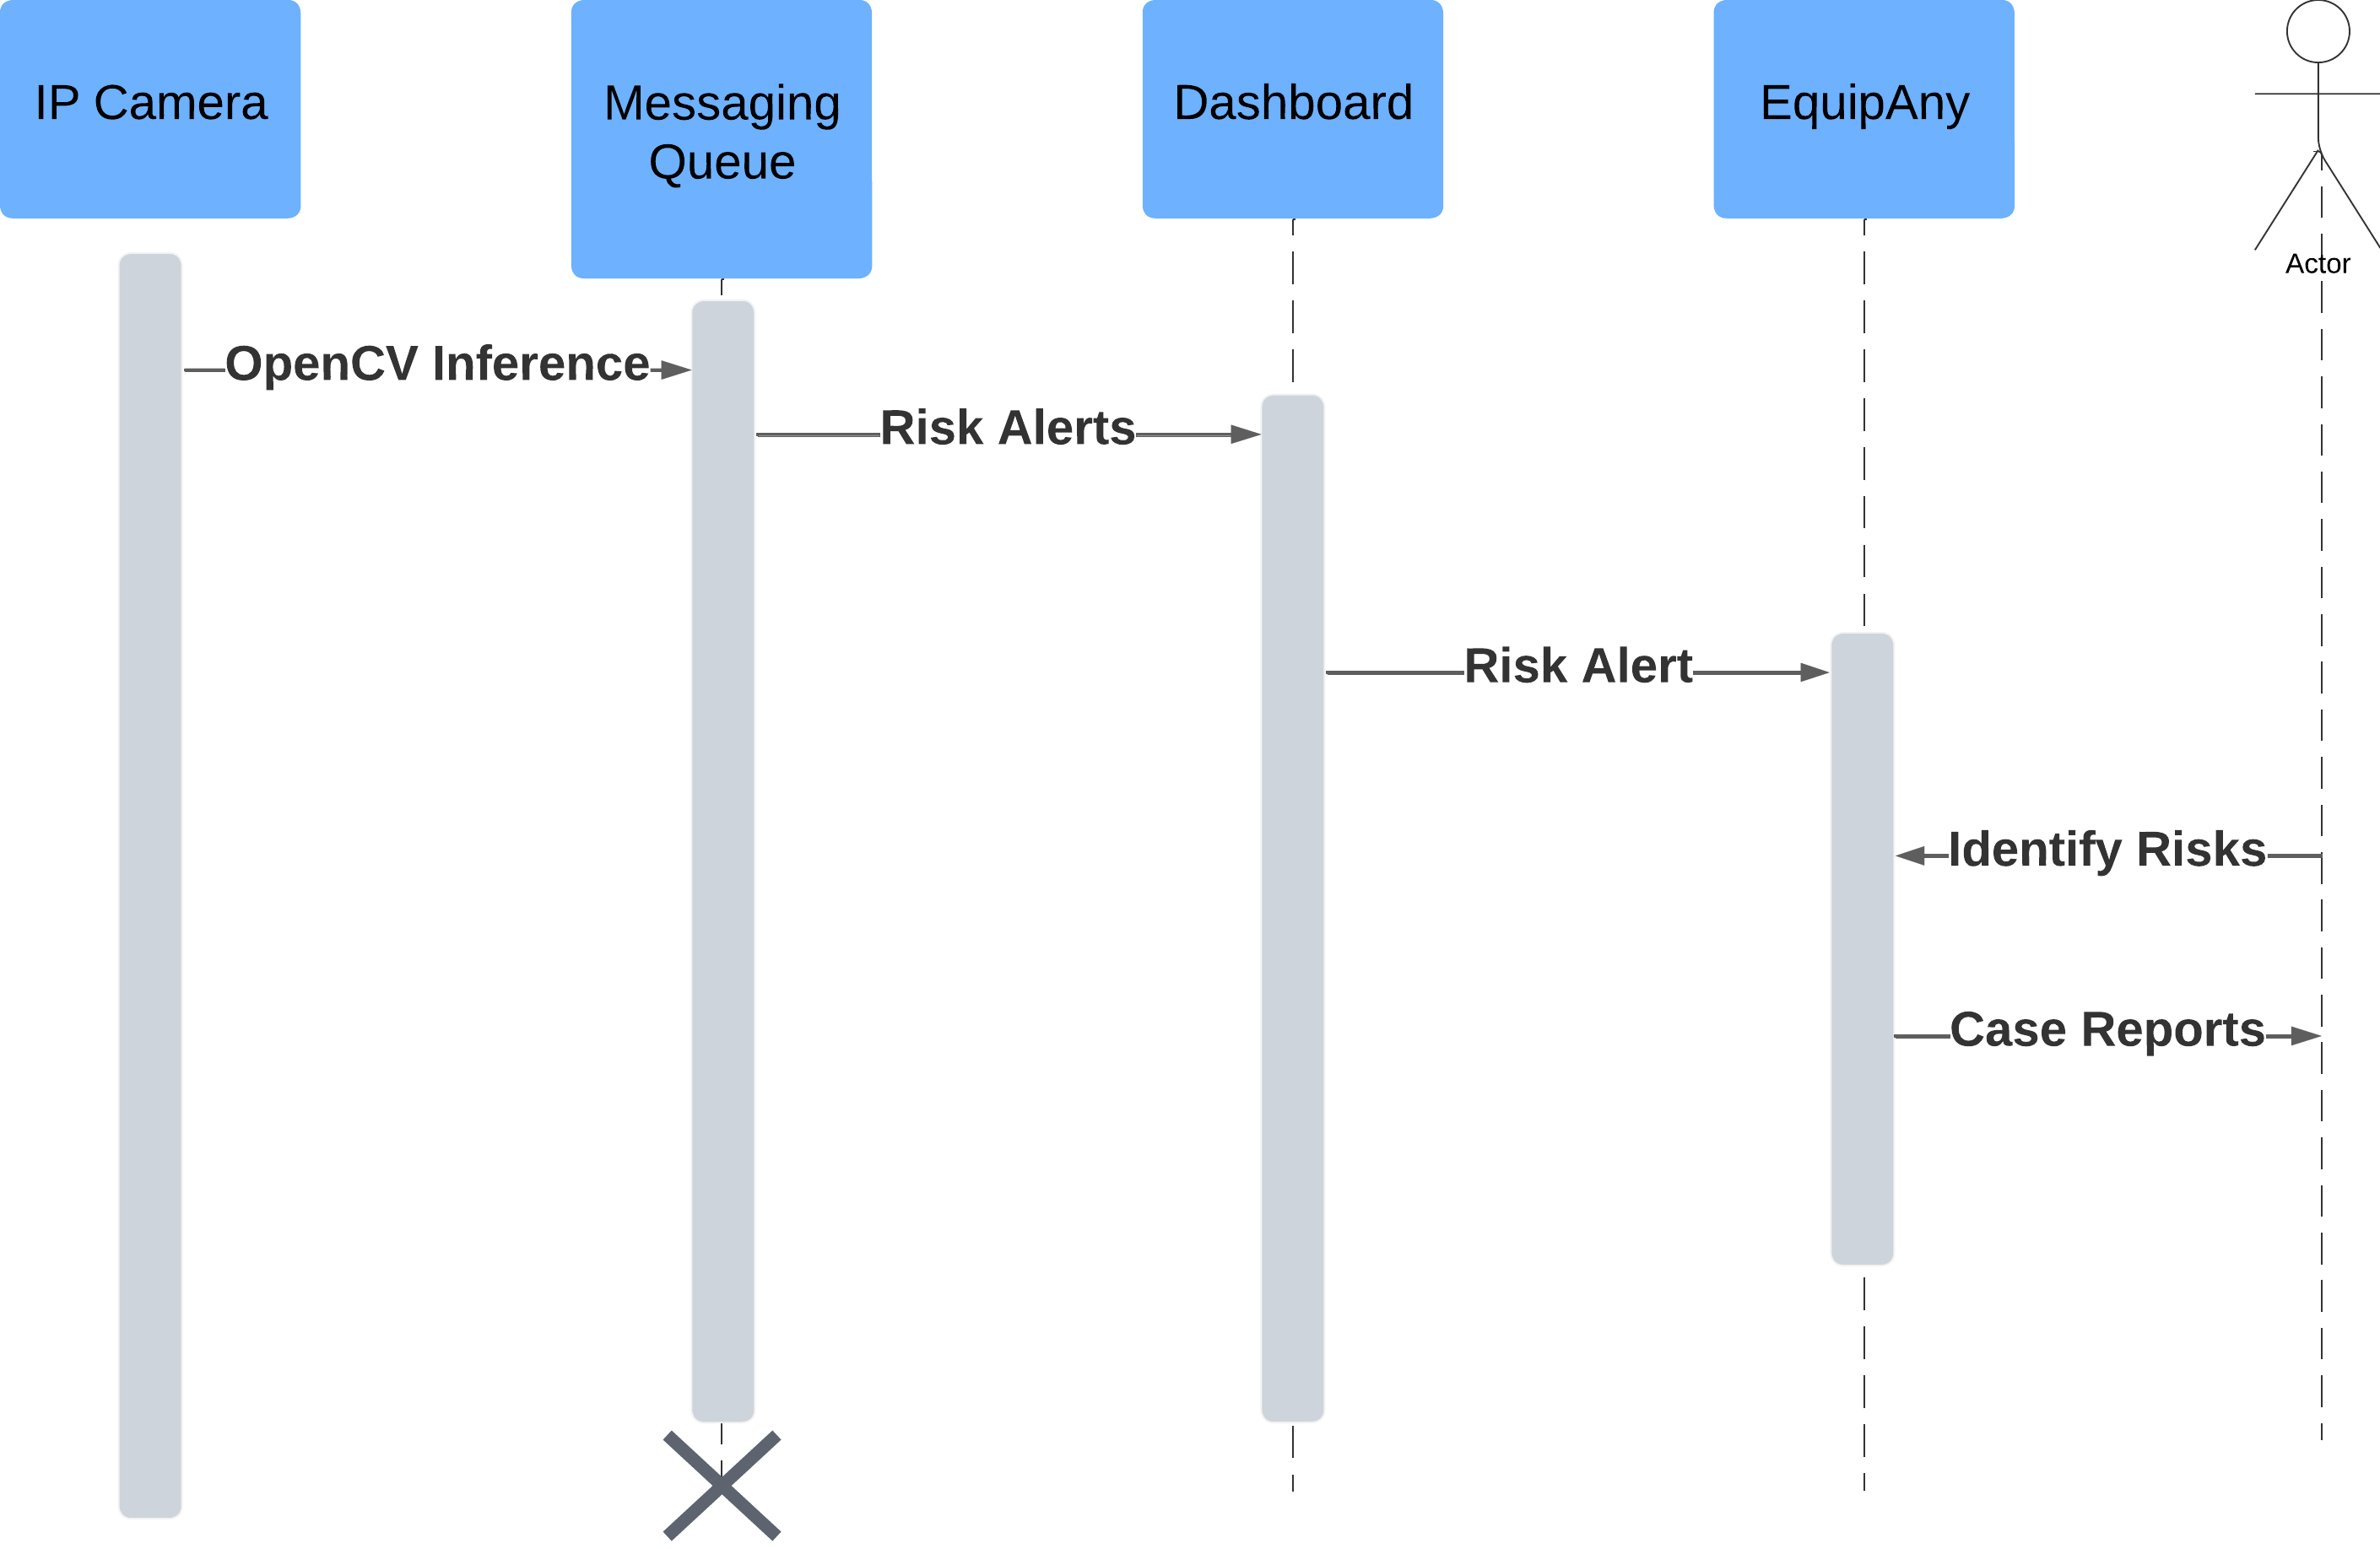
rApp - EquipAny

Slide 9
End of Slides
Questions?
Notes:
This is the End of Slides and any Questions are Answerable.

